Slide 1
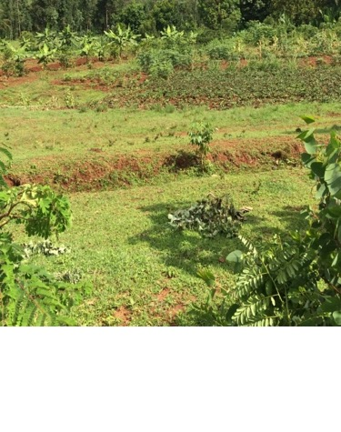
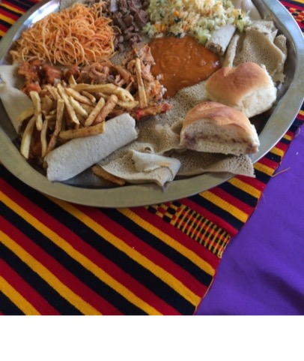
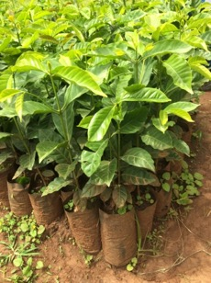
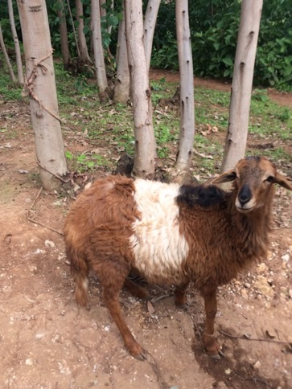
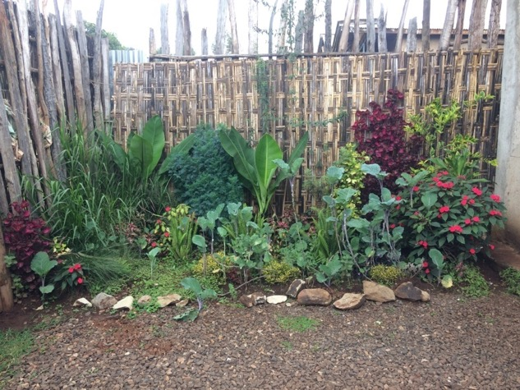
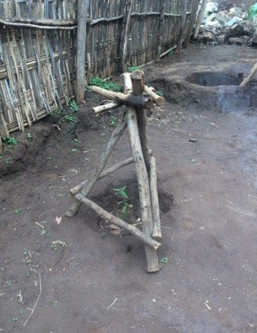
Farm to Table in Wolaita Curriculum Unit

Slide 2
Farm to Table in Wolaita
How do Ethiopians cultivate and utilize native crops for today and tomorrow?
Information gathered from on site observations and interviews with the Wolaita people provide valuable resources on the following topics:
Ethnobotany in Wolaita
Importance of home gardens
Indigenous traditions associated with foods
Wolaita Livestock
Using traditional knowledge combined with modern gardening/farming techniques
to overcome environmental challenges
Indigenous Ethiopian Technology & The Modern Maker Movement
Cultural Knowledge Embedded in the Crafting & Use of Tools: hand made tools for
everyday use in Wolaita
Creating String from the Common Milkweed Plant
Create Makerspaces and Organize a Trash Faire

Slide 3
Farm to Table In Wolaita Curriculum Unit
Indigenous Ethiopian Technology & The Modern Maker Movement
Lesson 1: Cultural Knowledge Embedded in the Crafting & Use of Tools

Slide 4
Farm to Table In Wolaita Curriculum Unit Indigenous Ethiopian Technology & The Modern Maker Movement
Cultural Knowledge Embedded in the Crafting & Use of Tools: hand made tools for everyday use in Wolaita
Creating String from the Common Milkweed Plant
Create Makerspaces and Organize a Trash Faire

Slide 5
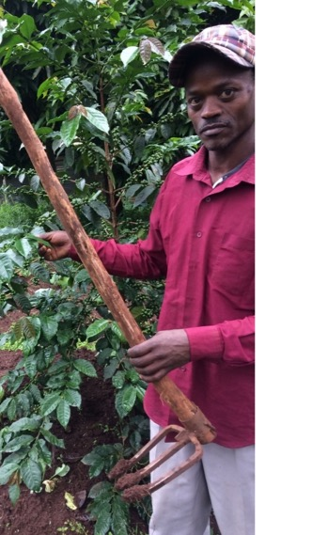
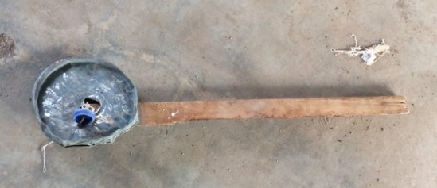
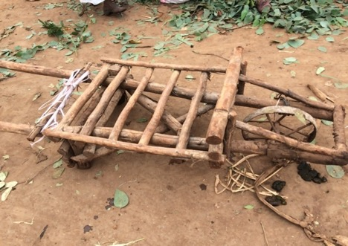
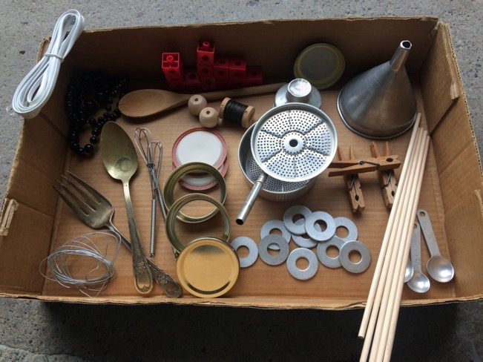
Indigenous Ethiopian Technology & The Modern Maker Movement Cultural Knowledge Embedded in the Crafting & Use of Tools

Slide 6
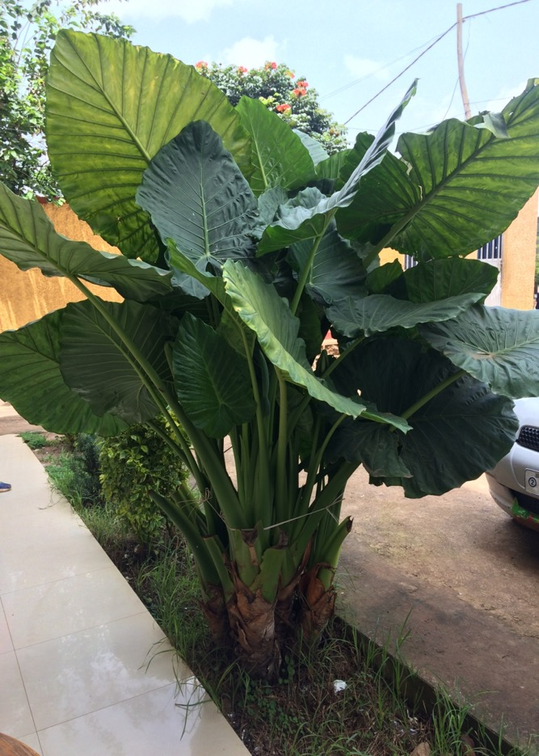
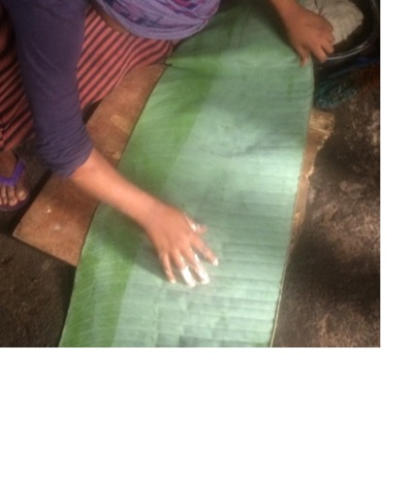
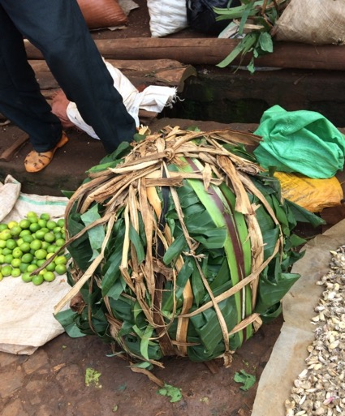
Cultural Knowledge Embedded in the Crafting & Use of Tools Using natural resources in a sustainable fashion for practical purposes
Women use banana leaves as a bake sheet to make cornbread. The cornbread mixture is enclosed in the leaf and placed on an open fire to cook/bake.
False Banana leaves are used to display & package qocho for the marketplace.

Slide 7
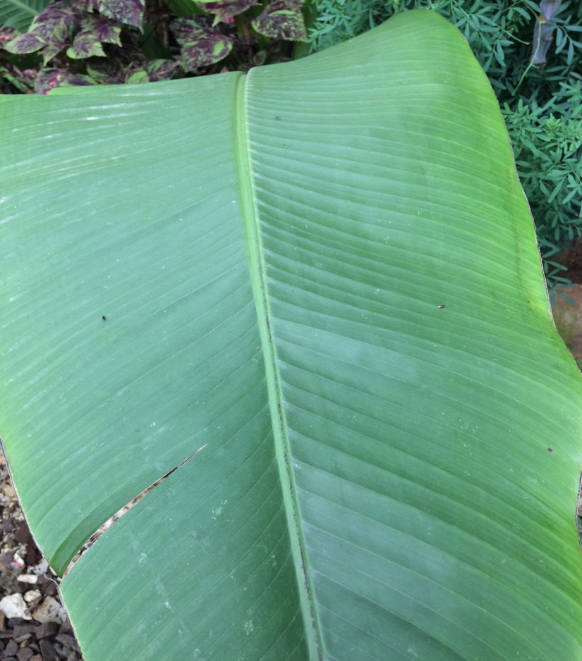
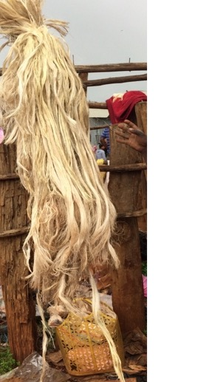
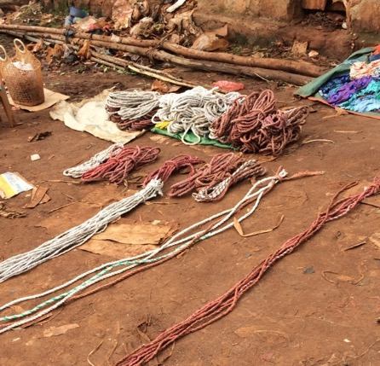
Cultural Knowledge Embedded in the Crafting & Use of Tools Using natural resources to create common tools: Ethiopians use fibers of the false banana to create string/rope.

Slide 8
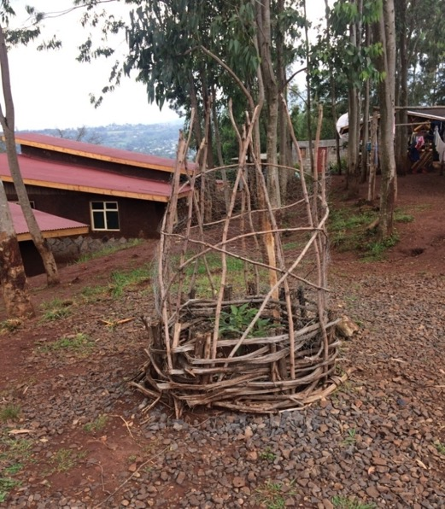
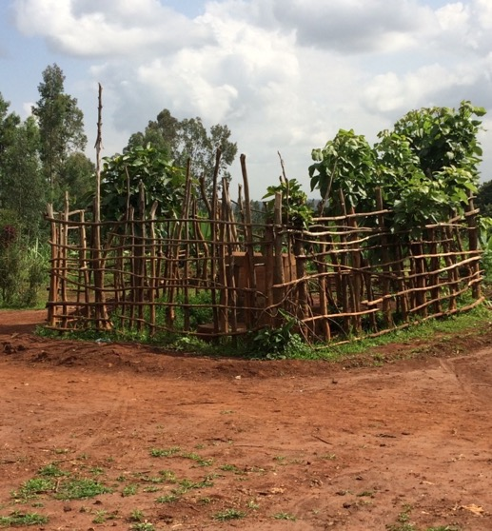
Cultural Knowledge Embedded in the Crafting & Use of Tools
Avacado Tripod Fence
Bumble Bee Fence
Fence to Protect Water Storage

Slide 9
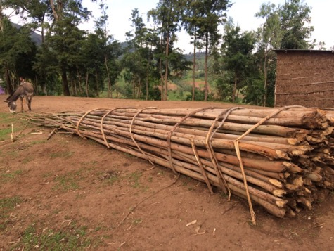
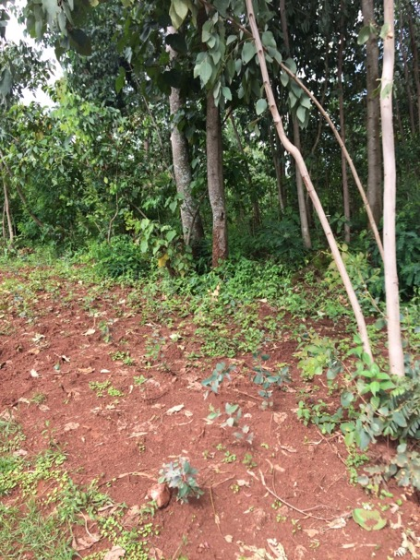
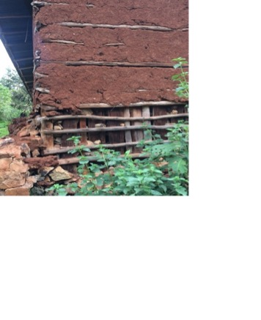
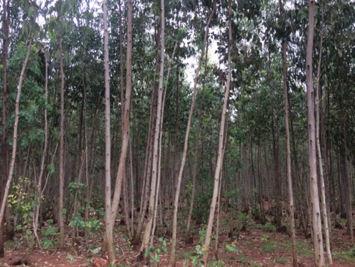
Cultural Knowledge Embedded in the Crafting & Use of Tools Using natural resources in a sustainable fashion for practical purposes
The eucalyptus tree is harvested to construct fences and the framework for houses.
To alleviate deforestation, eucalyptus trees are being planted in place of those cut for gardening , housing & construction purposes.

Slide 10
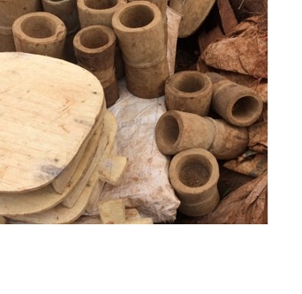
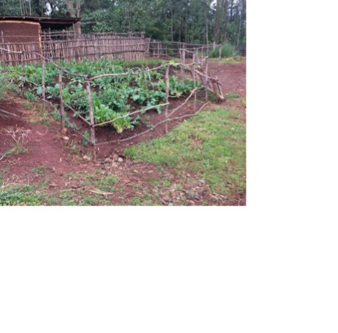
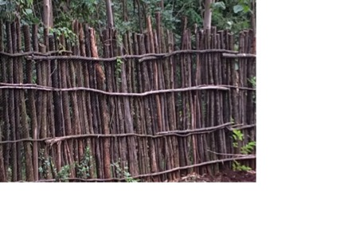
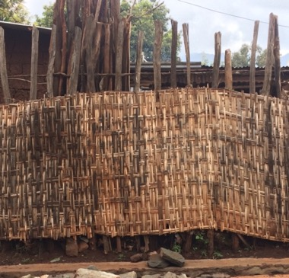
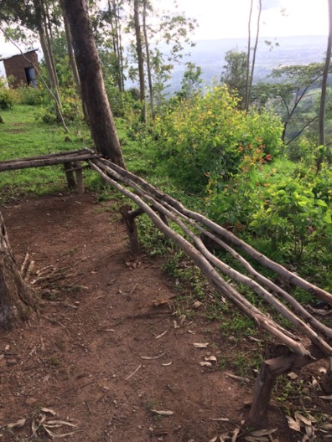
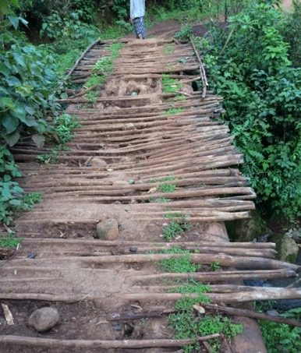
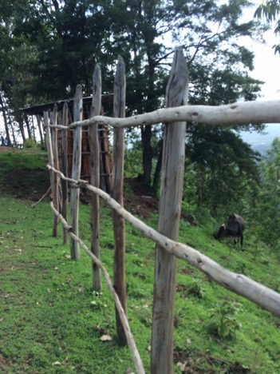
Cultural Knowledge Embedded in the Crafting & Use of Tools Using natural resources in a sustainable fashion for practical purposes
Privacy fences for residences
Wooden mortar used in grinding coffee beans
Garden fence protecting vegetables
Fence to protect cattle
Bridge over creek
Bench atop a mountain

Slide 11
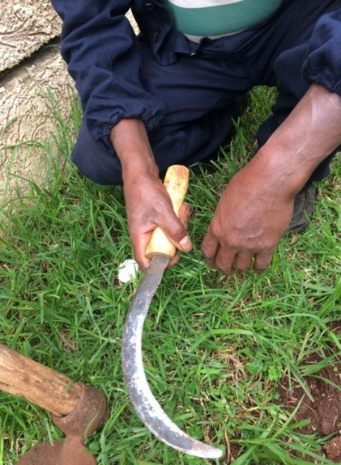
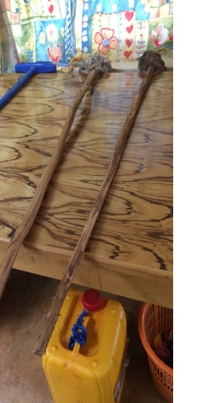
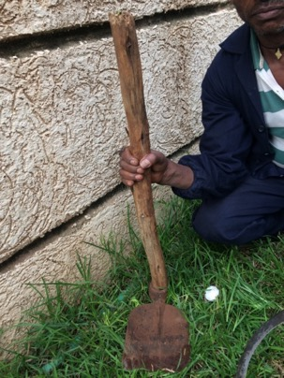
Cultural Knowledge Embedded in the Crafting & Use of Tools: hand made tools for everyday use in Wolaita
Handmade sickle for cutting grass.
Cleaning tool handles made from eucalyptus wood.
Gardener’s hoe & spade handle made from eucalyptus wood.

Slide 12
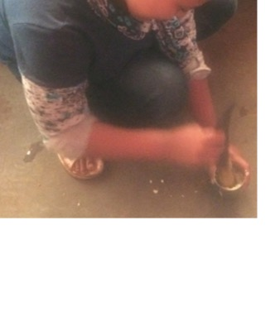
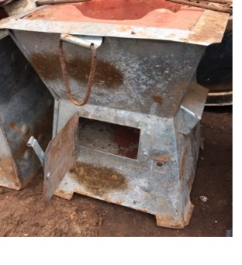
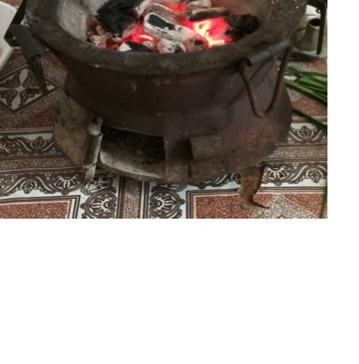
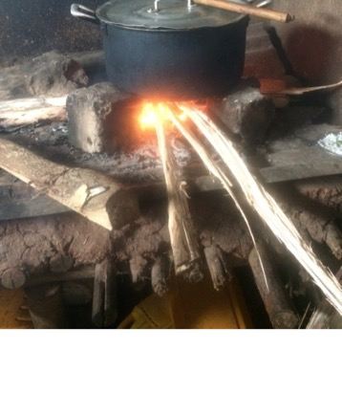
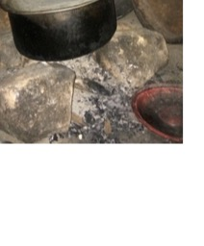
Cultural Knowledge Embedded in the Crafting & Use of Tools
An individual tool can be considered multifunctional--
This knife handle is also used as a tool to crush garlic for a recipe.
sickle
Rocks are used as a support for pots similar to a burner on a stove; rocks are also used in the framework of houses.
This stove is used to roast, boil & cook foods. Charcoal is used inside the lower chamber to create flames for cooking. Its unique feature is its mobility: it can be carried from one household room to another or outside the home for use.
Garden fence crafted from eucalyptus trees

Slide 13
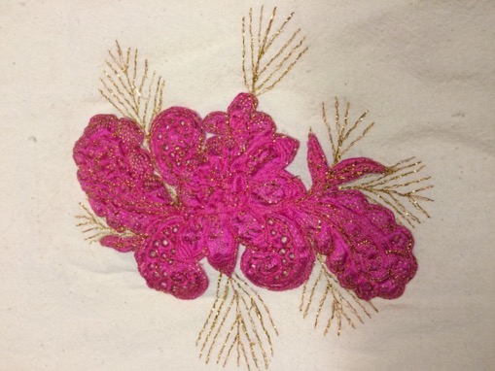
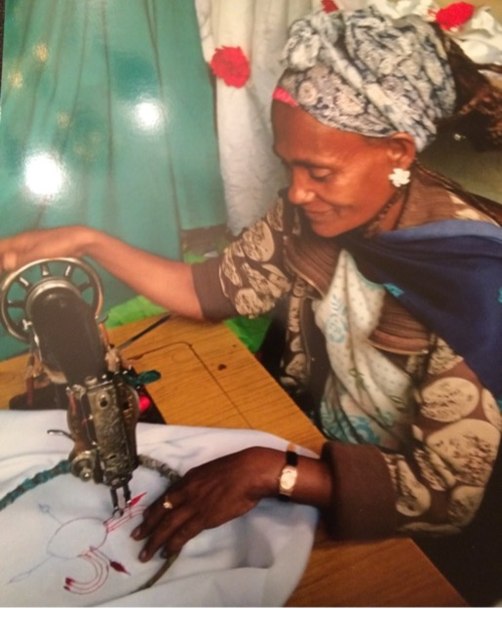
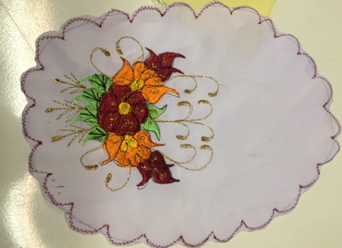
Cultural Knowledge Embedded in the Crafting & Use of Tools: Needlework: Knitting, Crocheting, Quilting: using yarn and thread to create items Traditional skills represented here are passed on from one generation to another.

Slide 14
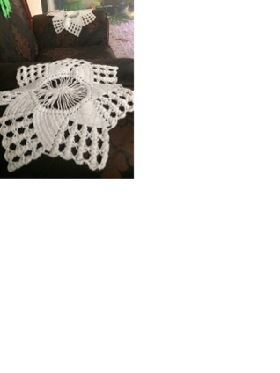
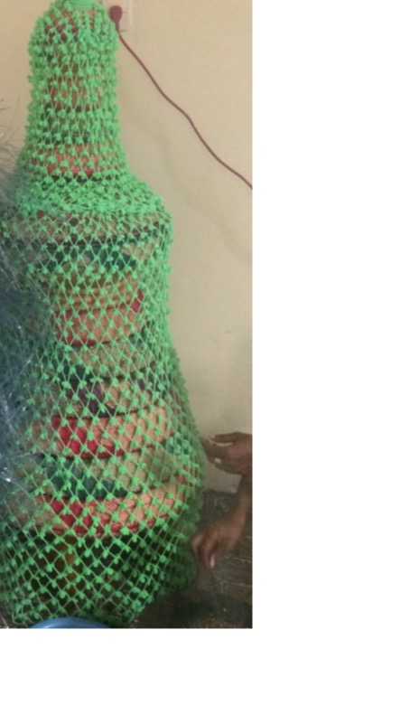
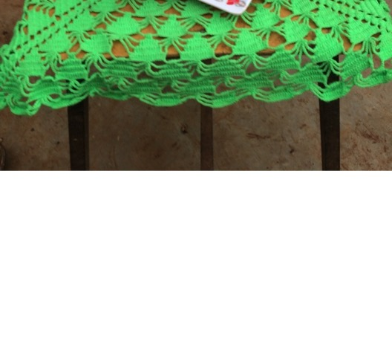
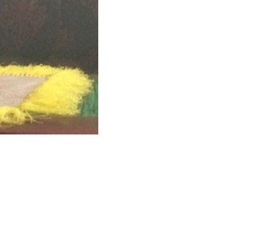
Cultural Knowledge Embedded in the Crafting & Use of Tools Needlework: Knitting, Crocheting, Quilting: using yarn and thread to create aesthetic and functional items

Slide 15
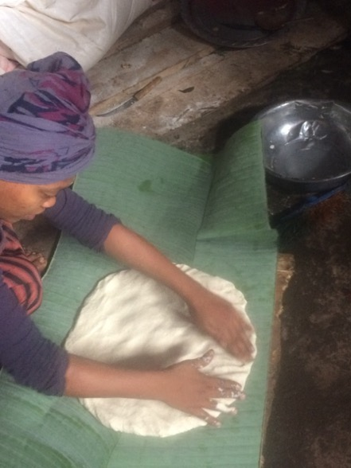
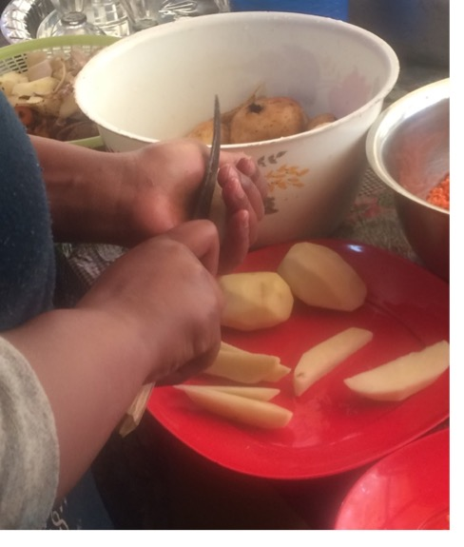
Cultural Knowledge Embedded in the Crafting & Use of Tools Wolaita People Using Their Hands as Tools
Wolaita individuals’ hands represent a genuine expression of the attentiveness, patience and joy they exude in their work. An individual’s hands are considered a traditional tool as well!
Forming cornbread
“Stirring” cornbread mixture
Peeling/cutting potatoes

Slide 16
Cultural Knowledge Embedded in the Crafting & Use of Tools Wolaita People Using Hands as Tools
Sharing knowledge by observing traditional ways of accomplishing tasks in the environment:
Processing grains, gardening/farming techniques, preparing meals, constructing homes, conducting coffee ceremonies

Slide 17
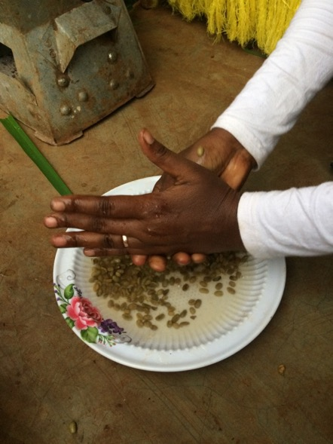
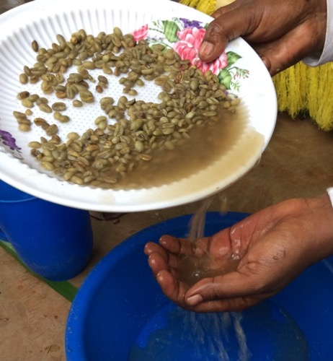
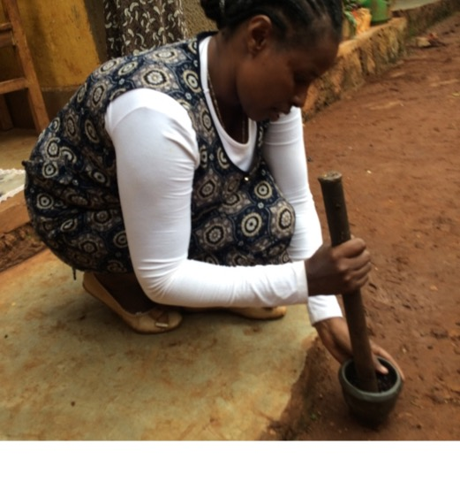
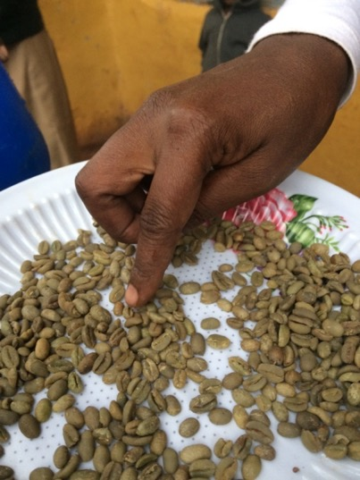
Cultural Knowledge Embedded in the Crafting & Use of Tools: Wolaita People Using Hands as Tools
Using hand as a sieve in washing/sorting coffee beans
Removing skins from coffee beans
Grinding coffee beans
Molding coffee topper
Weaning of coffee beans

Slide 18
Indigenous Ethiopian Technology & The Modern Maker Movement Lesson 2
a Creating String from the Common Milkweed Plant a
Native Americans of North America created string from various indigenous plants in their environment. The concept is similar to that of the Wolaita culture--making string/rope from the false banana tree.

Slide 19
Indigenous peoples of North America used milkweed fibers to weave fabric & make string. Here are instructions for harvesting fibers inside the milkweed plant and making string.
1. Remove pods & leaves from the stalk. Beginning at an end, pull away outer layer of bark from the stalk of the plant. Be careful when approaching areas where pods & leaves were removed so the bark doesn’t split.
Common milkweed plant
Cut the stalk of the plant in the fall.
2. Gently scrape your fingernails across the inside of the bark to remove the silk-like fibers. Repeat this procedure for the remainder of the length of the bark taking care the keep as many fibers together as possible.

Slide 20
Instructions for harvesting fibers inside the milkweed plant and making string continued…
4. Continue scraping the inside of the bark to gather the silk-like fibers completely until the end of the stalk.
5. Divide the length of the gathered fibers into two equally wide strips.

Slide 21
Instructions for harvesting fibers inside the milkweed plant and making string continued…
6. Lay the two strands of fibers on your thigh and begin to roll one section of both strands in a forward motion keeping one hand on one end of the strands to prevent raveling of the string. Then roll this same section in a reverse motion.
7. Repeat this same procedure in sections all of the way down the length of the fibers. You will probably have to dip the tips of your fingers into water as you’re rolling the fibers. This moisture will facilitate you rolling these fibers and create a tight twist to keep the string intact.
8. The finished product: you can tie a knot at the end of the strands to prevent raveling.

Slide 22
Indigenous Ethiopian Technology & The Modern Maker Movement
Lesson 3: Create Makerspaces and Organize a Trash Faire
The Wolaita culture’s tradition of hand made items is representative of innovativeness and utilitarinarism: items are uniquely constructed for practicality, and they are shared in the community.
There are many “makers” in the Wolaita culture. A “maker” is someone who uses materials they found in their environment in a resourceful manner and…they share their knowledge, skills, and help with others.

Slide 23
Indigenous Ethiopian Technology & The Modern Maker Movement
Upcycling or Repurposing: Ethiopian children taking “everyday” discarded objects and creating toys and games

Slide 24
Indigenous Ethiopian Technology & The Modern Maker Movement
Repurposing: practical, household items are constructed from scrapped materials
Spoon crafted from a discarded beverage can
Bottle caps are repurposed into a circular stand for the jebena (vessel to boil, prepare and serve coffee) to rest upon in a coffee ceremony.

Slide 25
Indigenous Ethiopian Technology & The Modern Maker Movement Upcycling or Repurposing: creating useful, new objects from discarded items
An empty palm oil container is recycled into many uses.
Decorative “planters”
Receptacle for collecting/storing water

Slide 26
Indigenous Ethiopian Technology & The Modern Maker Movement Upcycling or Repurposing: creating useful, new objects from discarded items
Mortar/pestle made from wood to grind coffee beans/note “shelf” made of rock used as a natural workspace
Wooden stick used as a “spoon” to stir food
Old teapot is used to pour injera batter

Slide 27
a Create Makerspaces and Organize a Trash Faire a
Challenge yourself to use your imagination and create purposeful or aesthetic artifacts from discarded items in your environment. Become a “maker.” Share your knowledge of designing and making items with your classmates in a designated space at school or home—”a makerspace.” Organize a Trash Faire to display the items you and your peers have created. Share your knowledge of repurposing with your community!

Slide 28
Indigenous Ethiopian Technology & The Modern Maker Movement: Examples of Student Projects created for a Maker “Trash Faire”
Old newspapers are rolled into “petals” & spray painted to create an aesthetic paper wall hanging and leftover wrapping paper is also reused to create a flower paper wall hanging.
Old whisks, chicken wire, household plastic wires and dryer lint can be recycled to make nesting materials for birds and hung outside.

Slide 29
Indigenous Ethiopian Technology & The Modern Maker Movement Examples of Student Projects created for a Maker “Trash Faire”
Animal sculpture created from unused food containers, old newspapers and deer antlers
Dress made from hand made paper with dried and pressed plant leaves (dusty miller, rose petals). The cascading leaves on dress are made from dried and pressed kale plant leaves and shells.
Unused plastic containers serve as pencil holders for home, school or office

